Slide 1

Collection Framework
www.cybage.com
Copyright © 2019 Cybage Software Pvt. Ltd. All Rights Reserved. Cybage Confidential. www.cybage.com

Slide 2
Agenda
Wrapper Classes
Need of Collection
Collection Hierarchy
List
Set
Iterating Collection
Sorting In Collection
Map
Stream API – Java 8 Feature
www.cybage.com

Slide 3
Wrapper Classes
Java provide 8 primitive data types
Sometimes there is a need to treat these primitives as objects
Therefore Java provides class counterparts for those primitive data
types which are known as Object Wrappers or Wrapper classes.
Wrapper classes provide home for methods & variables related to the
type.
There are certain classes which can deal only with Objects & not primitive types (here wrapper classes are useful) : e.g. Collections
Example: Integer i =new Integer(4);
int x = i.intValue();
int y = Integer.parseInt(“4”);
www.cybage.com

Slide 4
Auto Boxing and Unboxing
In JDK 1.5.x:
As any Java programmer knows, you can’t put an int (or other primitive value) into a collection.
Collections can only hold object references.
you have to box primitive values into the appropriate wrapper class
(which is Integer in the case of int).
When you take the object out of the collection, you get the Integer that you put in.
if you need an int, you must unbox the Integer using the intValue method
All of this boxing and unboxing is a pain, and clutters up your code
www.cybage.com

Slide 5
Auto Boxing and Unboxing
Before:
int i = 12;
ArrayList l = new ArayList();
l.add(new Integer(i)); …………… Explicit Boxing
Integr a= l.get(index);
int b= a.intValue(); ……………
Explicit Unboxing
www.cybage.com

Slide 6
Auto Boxing and Unboxing
Now:
The auto boxing and unboxing feature automates the process,
eliminating the pain and the clutter.
Example:
int i = 12;
ArrayList l = new ArrayList();
l.add(i); …………… Auto Boxing
int a = l.get(index); ………… Auto Unboxing
www.cybage.com

Slide 7
Need of Collection
Java's collection classes provides a higher level interface than arrays.
Arrays have a fixed size. Collections have a flexible size.
Efficiently implementing a complicated data structures (e.g., hash tables) on top of raw arrays is a demanding task. The standard HashMap gives you that for free.
There are different implementation you can choose from for the same set of services: ArrayList vs. LinkedList, HashMap vs. TreeMap.
www.cybage.com

Slide 8
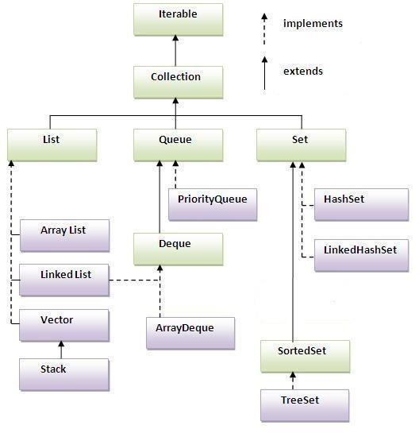
Collection Hierarchy
www.cybage.com

Slide 9
Collection Interface
Collection is an interface in the java.util package, and as its name suggests, it is used to define a collection of objects.
Methods in Collection Interface: boolean add (Object o) boolean addAll (Collection c) void clear()
boolean boolean
contains ( Object o) isEmpty()
Iterator iterator()
boolean remove (Object o)
int size()
www.cybage.com

Slide 10
List
Its an ordered collection.
Unlike sets, lists typically allow duplicate elements
They typically allow multiple null elements if they allow null elements at all
Example: ArrayList , LinkedList
www.cybage.com

Slide 11
List
import java.util.*; public class ListDemo
{
public static void main (String[] args)
{
List<String> friuts = new ArrayList<String>(); friuts.add(“Mango");
friuts.add(“Apple"); friuts.add(“StrawBerry"); friuts.add(“Orange"); friuts.add(“Kiwi");
List<String> range = new ArrayList<String>(); range = friuts.subList(2, 4);
System.out.println(range);
}
}
www.cybage.com

Slide 12
Set
Set : Its a Collection of unique elements
( i.e. a set contains no duplicate elements ) The elements are not ordered
Set can contain at most one null element
Example: HashSet
Sorted Set: It’s a sub interface of Set. It further guarantees iterator will traverse the set in ascending element order, according to the natural ordering of its elements)
Example: TreeSet
that its (sorted
www.cybage.com

Slide 13
Set
import java.util.*;
public class SetExample {
public static void main(String[] args) {
Set set = new HashSet(); set.add("one");
set.add("second");
set.add("3rd");
set.add(new Integer(4)); set.add(new Float(5.0F));
set.add("second"); set.add(new Integer(4)); System.out.println(set);
}
} What will be the Output ?
www.cybage.com

Slide 14
Iterating Collection – Iterator Interface
Allows the user to visit the elements of a collection one by one
It has three methods:
boolean hasNext()
Object next()
void remove()
Code Example:
List list = new ArrayList();
// add some elements
Iterator elements = list.iterator(); while ( elements.hasNext() ) {
System.out.println(elements.next());
}
www.cybage.com

Slide 15
Sorting In Collection
sort() method is present in java.util.Collections class which is used to sort any
(Predefined Type) List in ascending order.
Example –
Let us suppose that our list contains
{“Hello", "Friends", "Dear", "Is", "Superb"}
After using Collection.sort(), we obtain a sorted list as
{"Dear", "Friends", “Hello", "Is", "Superb"}
For applying sort method on User Defined Types Collection we require to implement
Comparable or Comparator interface.
www.cybage.com

Slide 16
Comparable Vs Comparator
Comparable lets a class implement its own comparison
It's in the same class (it is often an advantage)
There can be only one implementation (so you can't use that if you want two different sorting cases)
Comparator is an external comparison
It is typically in a unique instance (either in the same class or in another place)
You name each implementation with the way you want to sort things.
You can provide comparators for classes that you do not control.
www.cybage.com

Slide 17
Comparable Vs Comparator
To implement Comparable interface, class must implement a single method compareTo()
public int compareTo(Object o){}
To implement Comparator interface, class must implement a single method compare() public int compare (Object obj1 , Object obj2){}
www.cybage.com

Slide 18
Map
An object that maps keys to values.
A map cannot contain duplicate keys
Each key can map to at most one value.
Map
SortedMap
TreeMap
HashMap
LinkedHashMap
The Map interface provides three collection views,
which allow a map's contents to be viewed as:
a set of keys
a collection of values
a set of key-value mappings
Examples : HashMap,TreeMap
www.cybage.com

Slide 19
Map Demo
Class MapDemo{
p.s.v.main(String args[]){
HashMap<String,Integer> hm=new HashMap<>();
hm.put("Let us c",300);
hm.put("Let us c++",400); hm.put("Thinking in Java",350);
Iterator itr=hm.entrySet().iterator();
while(itr.hasNext())
{
System.out.println(itr.next());
}
}
} Output Generated: Let us c=300 Thinking in Java=350 Let us c++=400
www.cybage.com

Slide 20
Stream API – Java 8 Feature
The Stream API is used to process collections of objects.
A stream is a sequence of objects that supports various methods which can be pipelined to produce the desired result.
Each intermediate operation is lazily executed and returns a stream as a result, hence
various intermediate operations can be pipelined.
Following are the different operations On Streams-
Intermediate Operations: Terminal Operations:
map filter sorted
collect forEach reduce
www.cybage.com

Slide 21
Stream API – Java 8 Feature
map :
List number = Arrays.asList(2,3,4,5);
List square = number.stream().map(x->x*x).collect(Collectors.toList());
filter :
List names = Arrays.asList("Reflection","Collection","Stream");
List result = names.stream().filter(s->s.startsWith("S")).collect(Collectors.toList());
sorted:
List names = Arrays.asList("Reflection","Collection","Stream");
List result = names.stream().sorted().collect(Collectors.toList());
www.cybage.com

Slide 22
Stream API – Java 8 Feature
collect:
List number = Arrays.asList(2,3,4,5,3);
Set square = number.stream().map(x->x*x).collect(Collectors.toSet());
forEach:
List number = Arrays.asList(2,3,4,5);
number.stream().map(x->x*x).forEach(y->System.out.println(y));
reduce:
List number = Arrays.asList(2,3,4,5);
int even = number.stream().filter(x->x%2==0).reduce(0,(ans,i)-> ans+i);
www.cybage.com

Slide 23
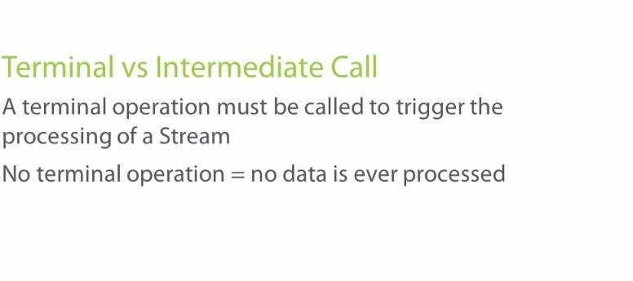
www.cybage.com
Terminal Vs Intermediate Call

Slide 24

www.cybage.com

Slide 25
Thank You!
www.cybage.com
Copyright © 2019 Cybage Software Pvt. Ltd. All Rights Reserved. Cybage Confidential._{11/12/2020} www.cybage.com 26

